Slide 1
Kausik. T
Final Project

Slide 2
PROJECT TITLE
Image Caption Generator

Slide 3


AGENDA
The agenda of the project appears to be to develop an image captioning system. Image captioning is the task of automatically generating textual descriptions or captions for images. The main goals and agenda of this project can be summarized as follows:
Data Preparation
Model Architecture
Training
Evaluation
Fine-tuning and Optimization
Application
3/21/2024 Annual Review

Slide 4

PROBLEM STATEMENT
The problem statement of the project is to develop an effective image captioning system. More specifically, the project aims to address the following challenges:
Automatic Image Description
Understanding Visual Content
Complex Relationship Learning
Natural Language Generation
Scalability and Efficiency

Slide 5

PROJECT OVERVIEW
The project overview involves the following key components and steps:
Data Collection
Data Preprocessing
Feature Extraction
Tokenization
Model Architectures
Training
Caption Generation

Slide 6

WHO ARE THE END USERS?
The image captioning project could serve a variety of end users across different domains and industries. Some potential end users include:
Visually Impaired Individuals
Content Creators and Social Media Users
Image Search Engines
E-commerce Platforms
Healthcare Professionals
Computer Vision Researchers and Developers

Slide 7

YOUR SOLUTION AND ITS VALUE PROPOSITION
The solution and value proposition of the image captioning
project lie in its ability to automatically generate descriptive
captions for images. It includes:
Automatic Image Description
Enhanced Accessibility
Improved User Experience
Efficiency and Scalability
Time and Cost Savings
Versatility and Adaptability

Slide 8

THE WOW IN YOUR SOLUTION
The "wow" factor in the solution of the image captioning project
lies in its ability to seamlessly bridge the gap between visual
content and natural language. Here are some aspects that
contribute to the "wow" factor:
Automated Description Generation
Real-time Captioning
User Experience Enhancement
Innovation in AI and Computer Vision
3/21/2024 Annual Review

Slide 9
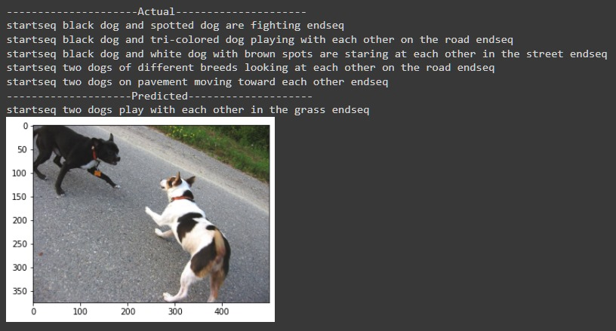
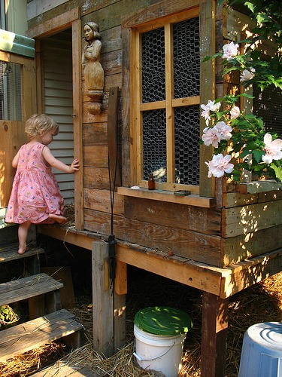
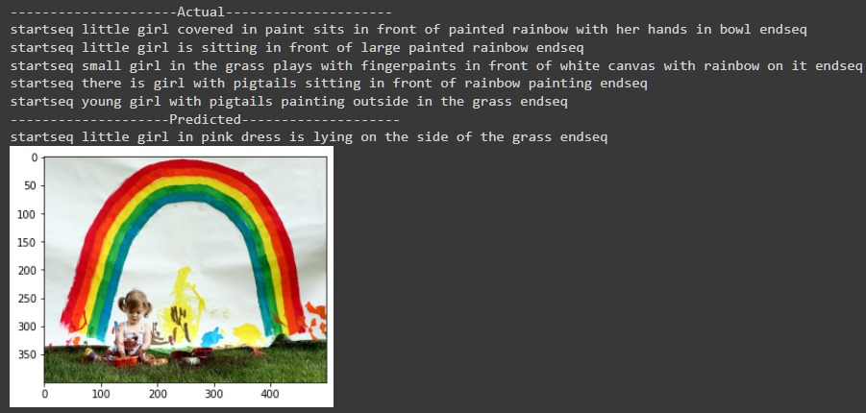
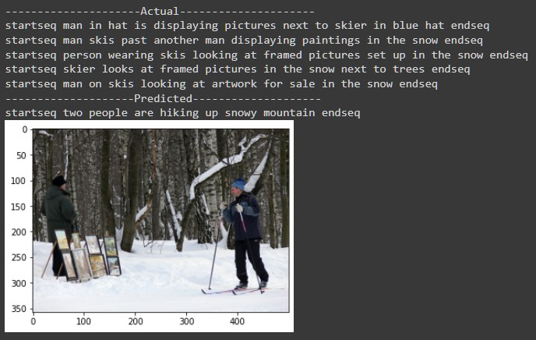
MODELLING
Output of Real-Time Image

Slide 10
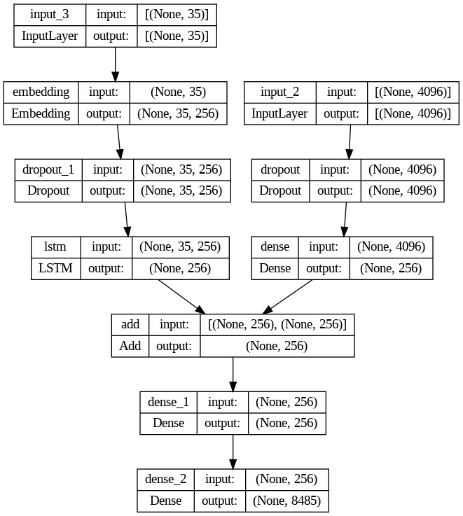
RESULTS
Output of Real-Time Image
GitHub Link: https://github.com/kausik-t/NM_GEN_AI_241056

